Slide 1

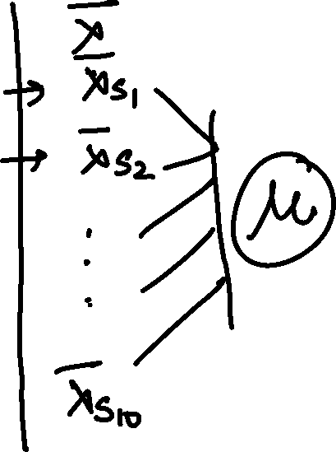
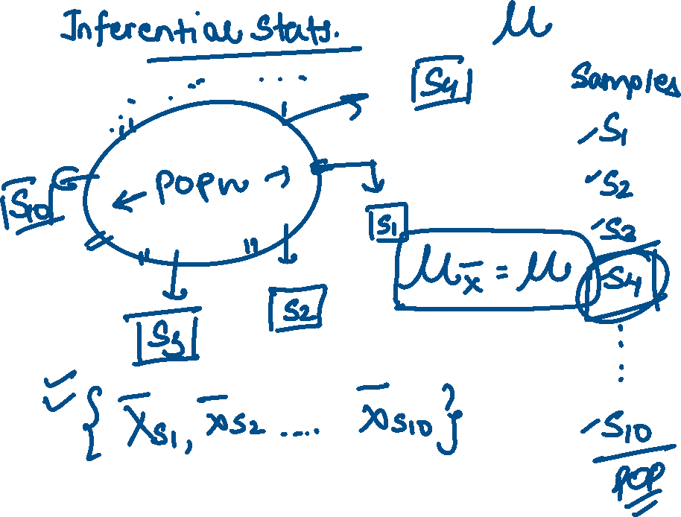



Slide 2

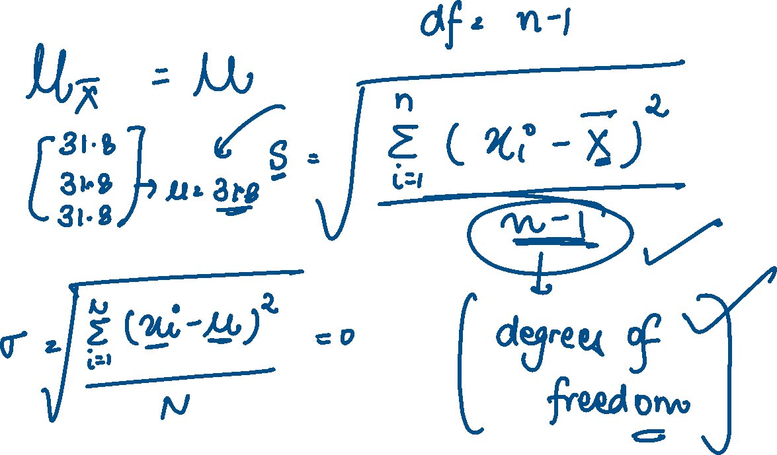


Slide 3

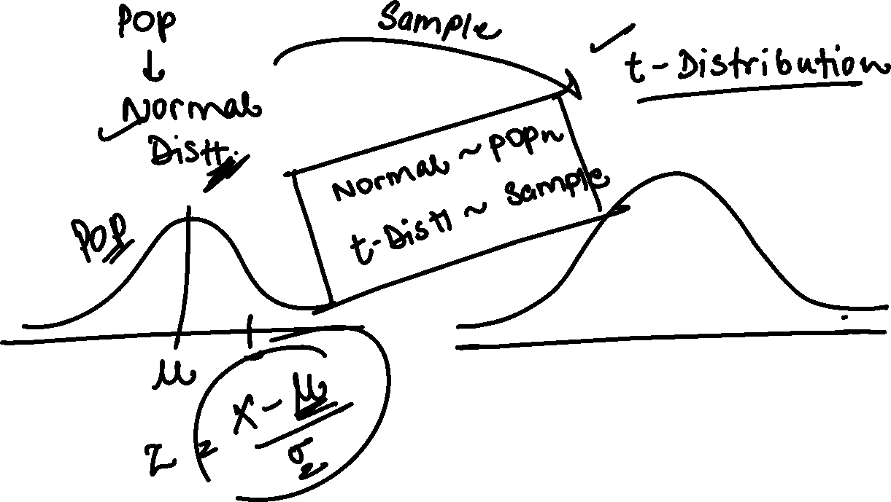

Slide 4





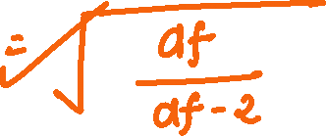










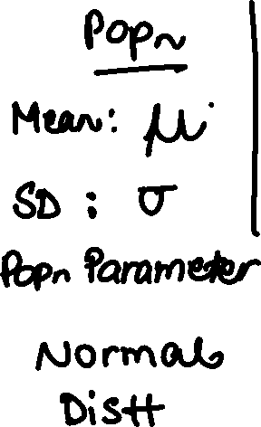












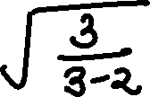








Slide 5




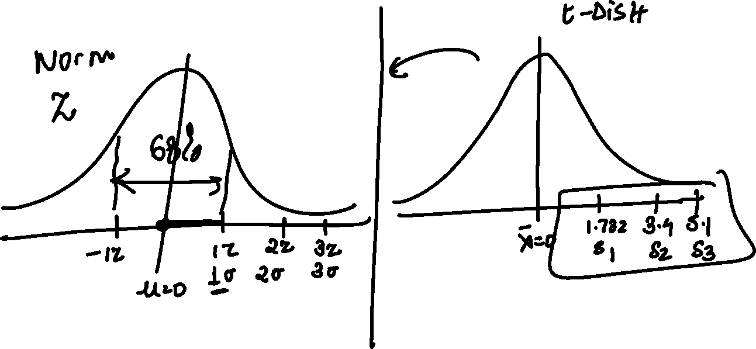




Slide 6



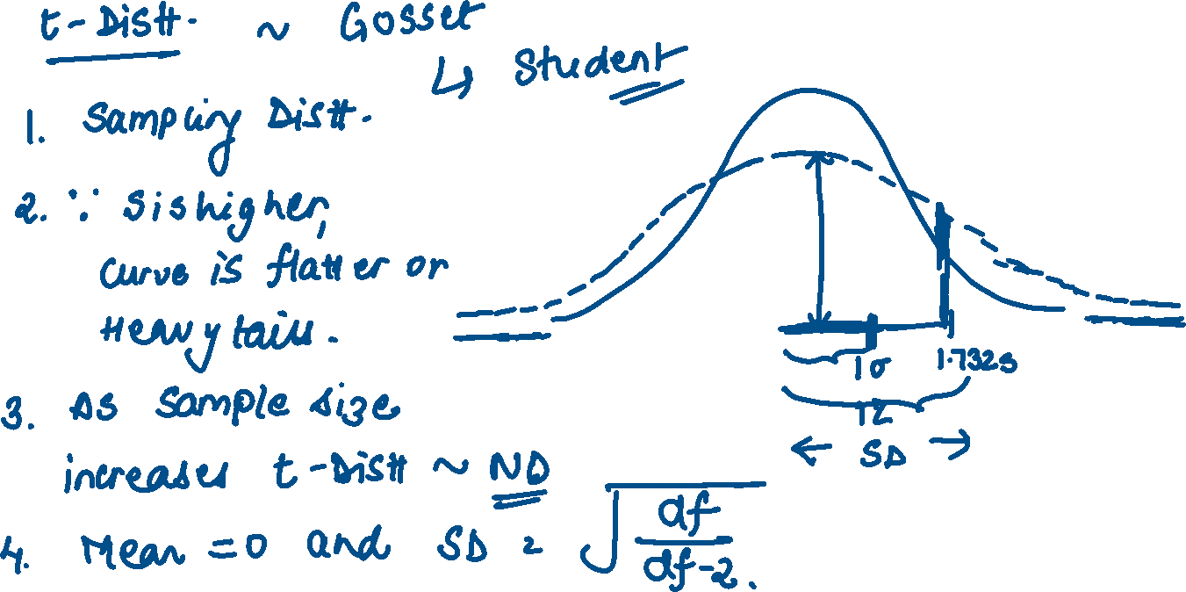





Slide 7











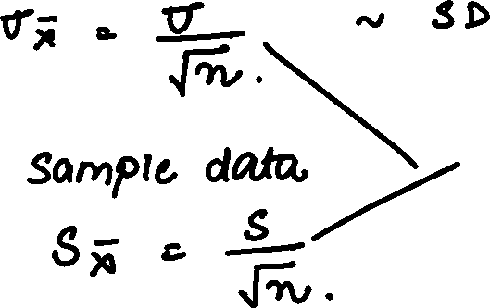

Slide 8





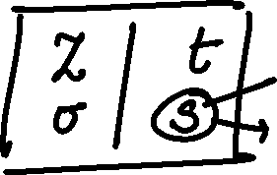



























Slide 9

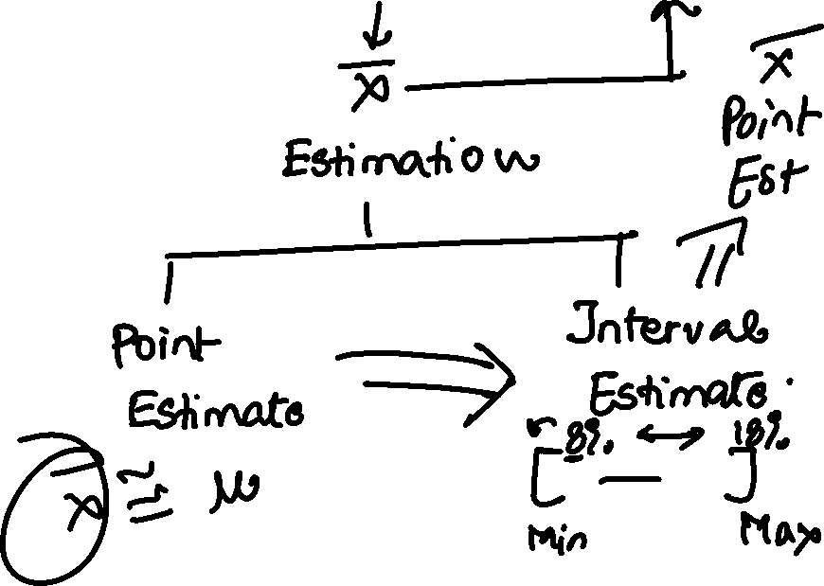








Slide 10

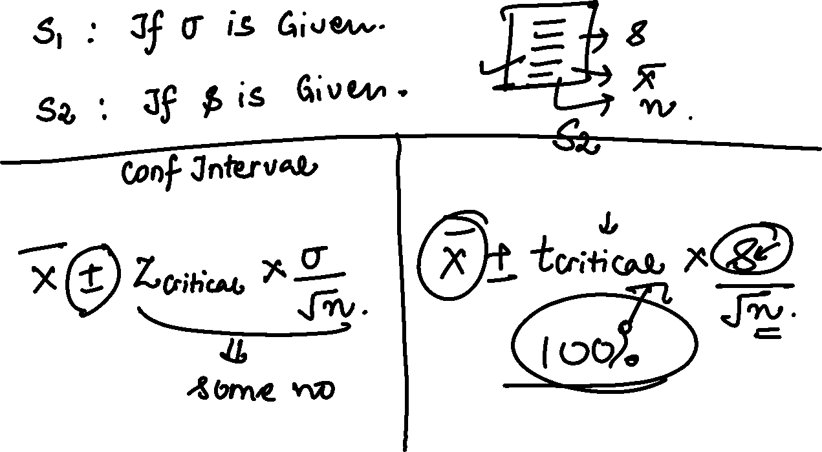

Slide 11




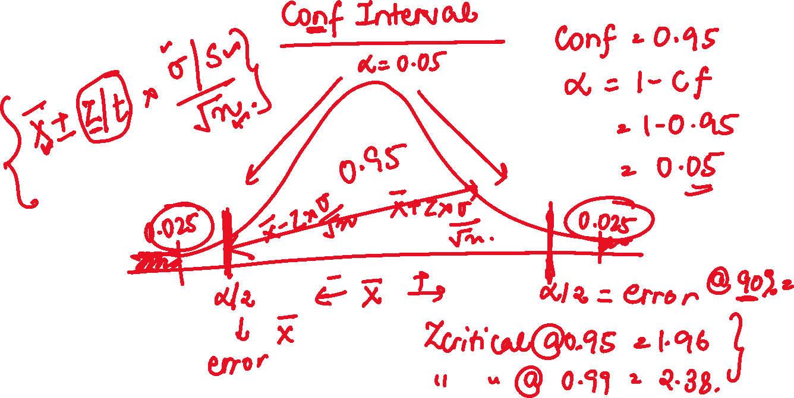


Slide 12








A publishing company has just published a new college textbook. Before the company decides the price at which to sell this textbook, it wants to know the average price of all such text-books in the market.
The research department at the company took a sample of 25 comparable textbooks and collected information on their prices. This information produced a mean price of $145 for this sample. It is known that the standard deviation of the prices of all such textbooks is $35 and the population of such prices is normal.
a) What is the point estimate of the mean price of all such college textbooks?
(b) Construct a 90% confidence interval for the mean price of all such college textbooks.

Slide 13































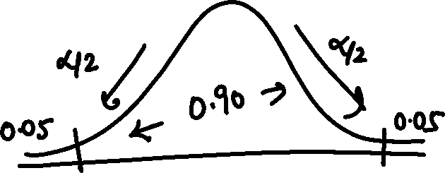









Slide 14


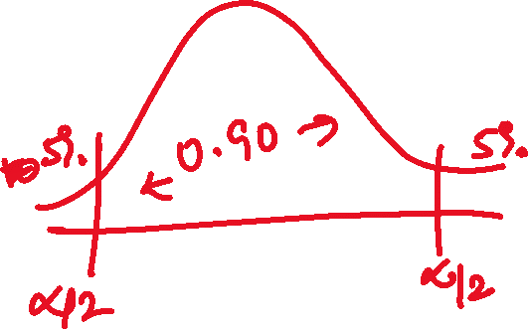
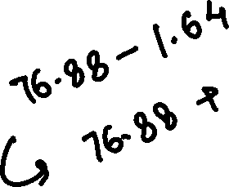
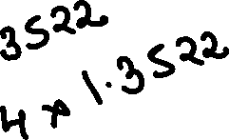





Slide 15






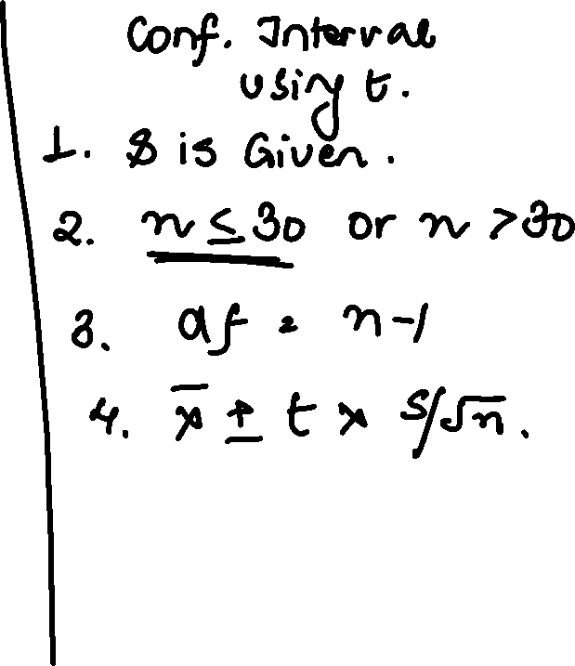













Slide 16


